Slide 1
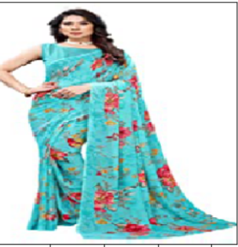
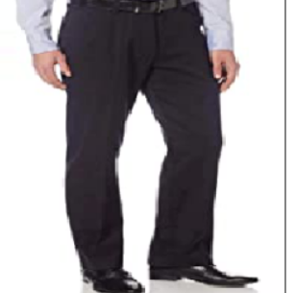
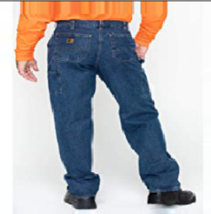
Image Scraping & Classification
Submitted by:
Deepthi Mallu

Slide 2
PROBLEM STATEMENT
Image classification is a fascinating deep learning project. Specifically, image classification comes under the computer vision project category.
The Image classification problem is to categorize all the pixels of a digital image into one of the defined classes. It is the most critical use case in digital image analysis. It is an application of both supervised classification and unsupervised classification.
Images are one of the major sources of data in the field of data science and AI. This field is making appropriate use of information that can be gathered through images by examining its features and details. In this I need to scrape the images from ecommerce website.
The clothing categories used for scraping are:
Sarees (women)
Trousers (men)
Jeans (men)

Slide 3
Review of Literature
Image classification is a complex procedure which relies on different components. Here, some of the presented strategies, issues and additional prospects of image orders are addressed.
The primary spotlight will be on cutting edge classification methods which are utilized for enhancing characterization precision.
Deep learning (DL) is a sub field to the machine learning, capable of learning through its own method of computing.
A deep learning model is introduced to persistently break down information with a homogeneous structure like how a human would make determinations.
To accomplish this, deep learning utilizes a layered structure of several algorithms expressed as an artificial neural system (ANN).

Slide 4
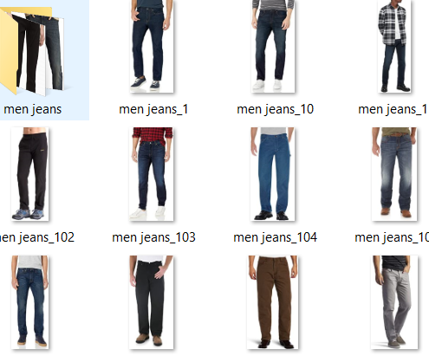
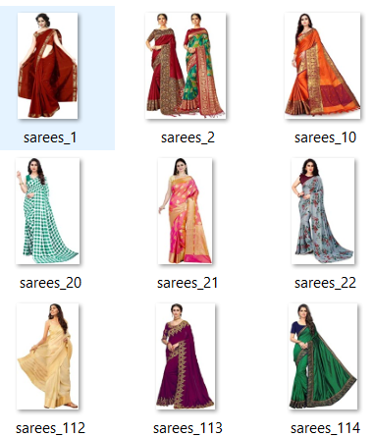
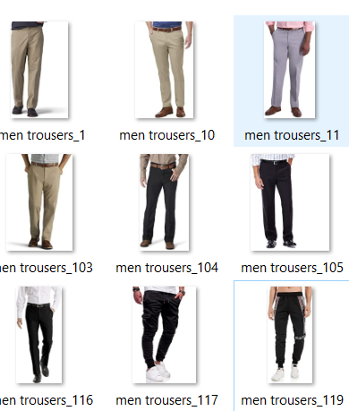
Data Sources and their formats
Data has been scraped from amazon.com using a python script which with selenium. All the data is in the .jpg image format. I have over 300 images per class.

Slide 5
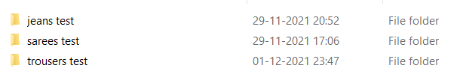
Data Pre-processing
I have first labelled the image data and then manually removed irrelevant images that were downloading with the script and removed the duplicate images. I have also performed multiple data augmentation techniques in order to train the model and get multiple angles and orientation of the same image.

Slide 6
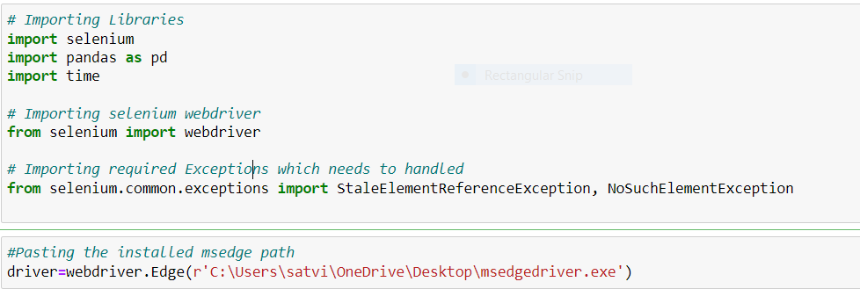
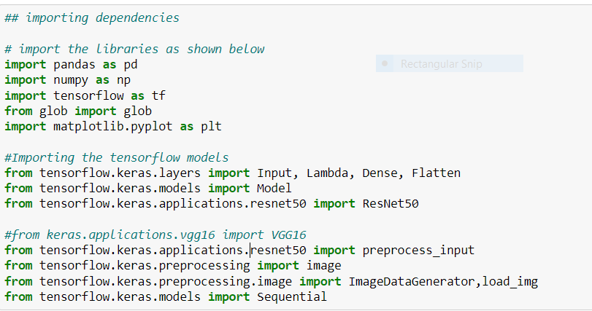
Hardware and Software Requirements and Tools Used

Slide 7
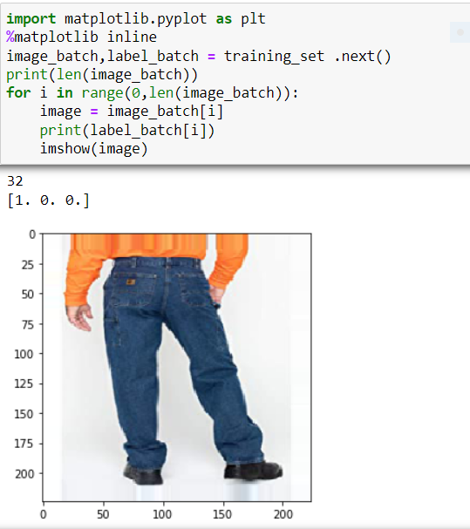
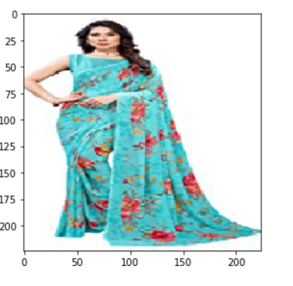
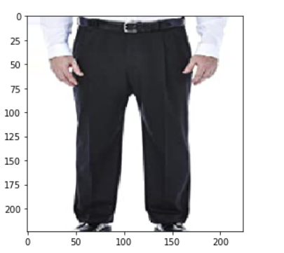
Visualization

Slide 8
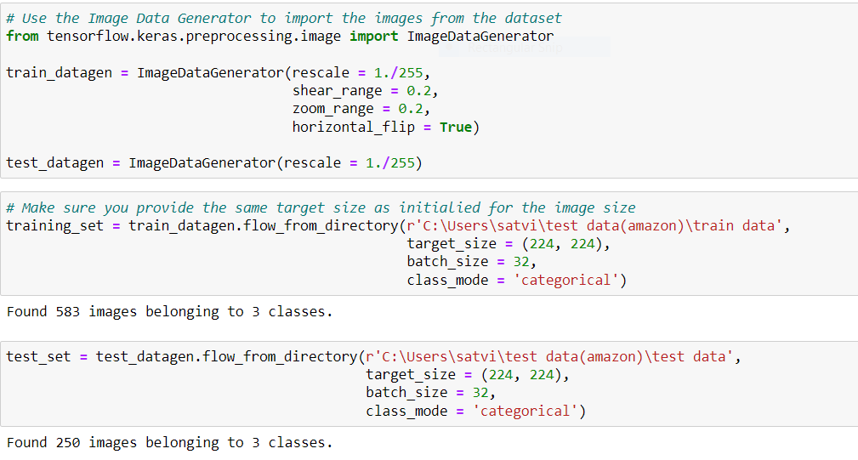
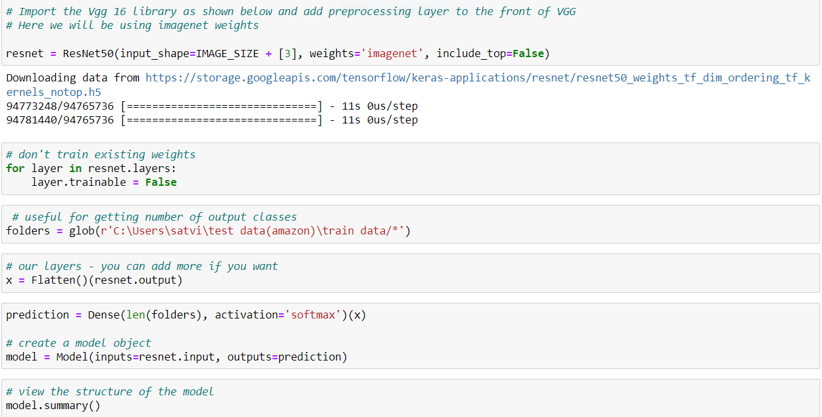
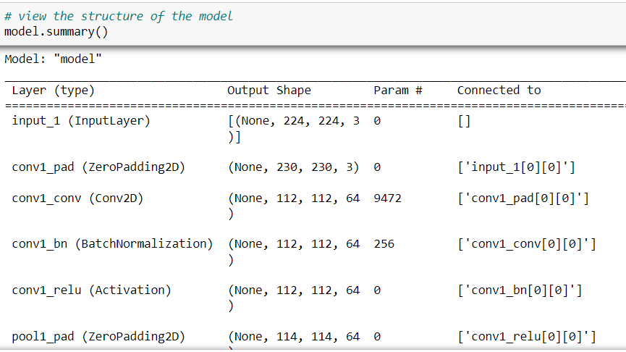
MODEL/S DEVELOPMENT AND EVALUATION

Slide 9
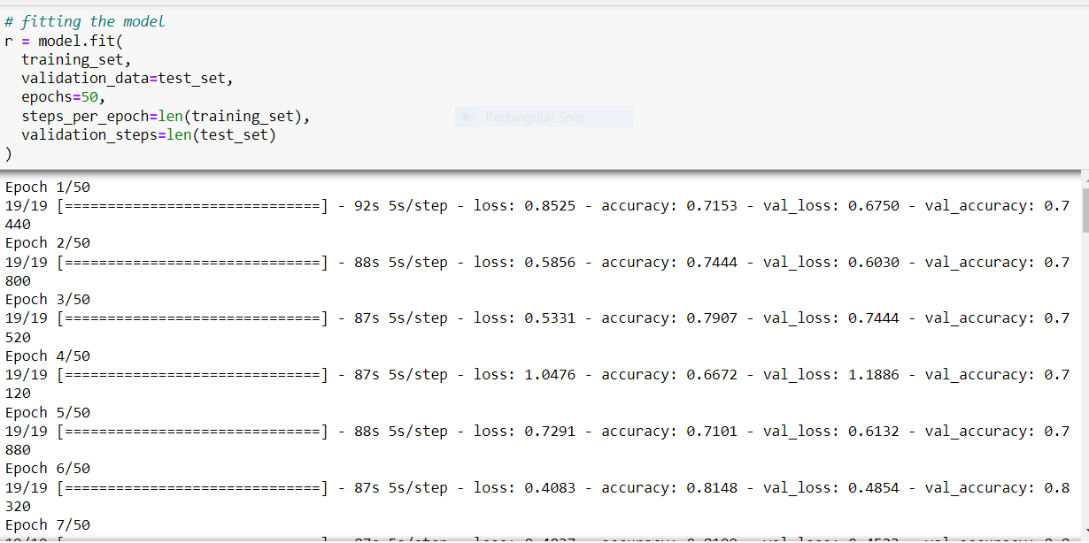
Testing of Identified Approaches (Algorithms)

Slide 10
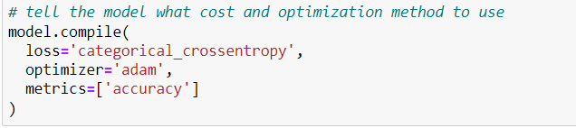
Metrics for success in solving problem under consideration:

Slide 11
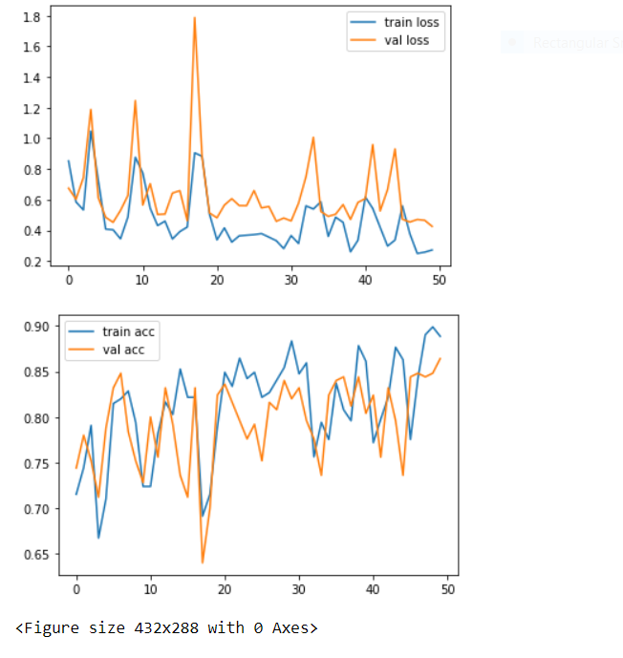
Interpretation of the Results

Slide 12
CONCLUSION
Our model was successfully to classify the images with an accuracy of 89.8% Percent on a test set of around 250 images.

Slide 13
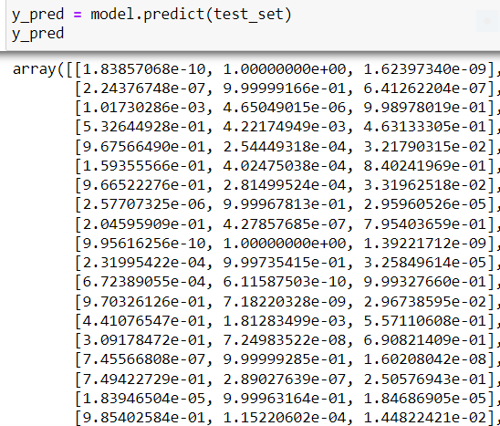
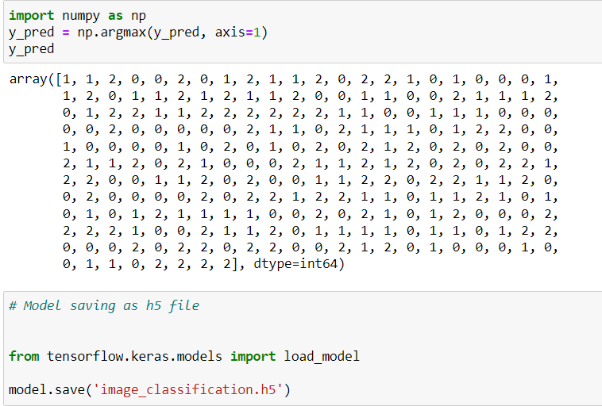
Key Findings and Conclusions of the Study

Slide 14
Limitations of this work and Scope for Future Work
The larger the dataset, the better the model accuracy but in this project, we have scraped the images only from amazon with three different classes so the scraped images are very less. In future we may scrape the data from different ecommerce websites and collect huge data and get the better results.

